Slide 1
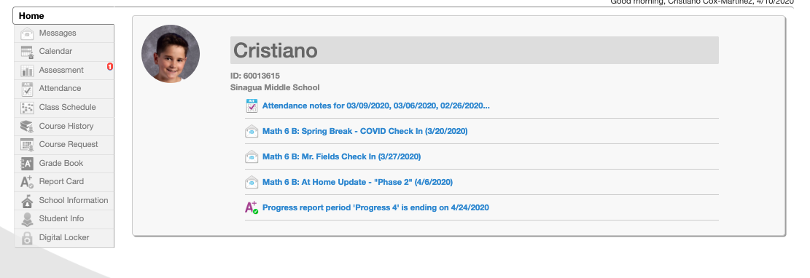
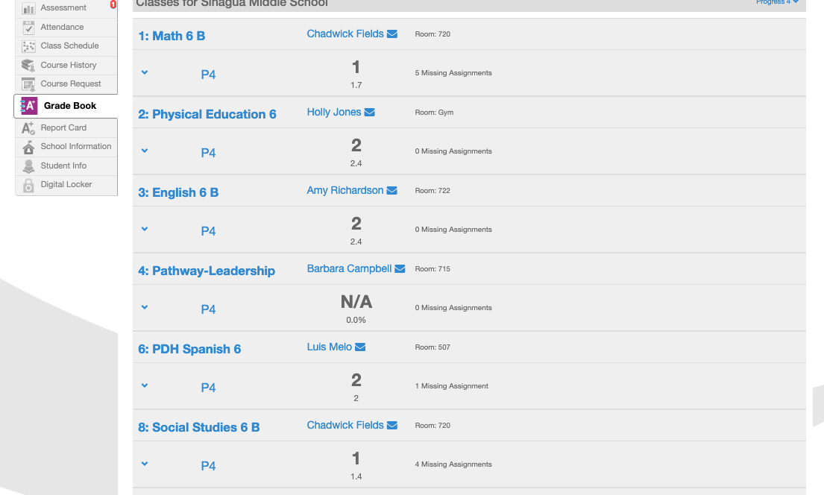
Quick StudentVue Guide
STEP 1: LOGIN
Welcome to your studentvue home screen – a picture of baby shark
BABY SHARK
STEP 2: Click “Gradebook”
When you click Grade Book it takes you to this page
STEP 3: Click on Subject(s) with a grade less than 2.0
Once you are in your gradebook, click on the class where you are not doing so well. When you click the class, this shows up…
Next click on [expand all] under the core name

Slide 2
When you [expand all], it will break down standards by assignment.. Anything with a 1, I highly recommend that you redo. Those are the grades pulling your overall grade down. The best way to handle this is to email your teacher and ask how you can go about doing this.
STEP 4: Click “Expand All” and see what assignments are bringing down your grade
Standard
Assignment
1.
2.
3.
4.
So, if this was my class. I would ask to redo the 4 assignments above.
STEP 5: Email your teacher directly to ask for information about how to make this up.
STEP 6: Breathe. Work hard. And be proud of any and all the work you are doing right now!

